Slide 1

Analytical Customer Relationship Management

Slide 2
01
02
03
Key Elements
Our Starting Point
Get to know us
TABLE OF CONTENTS
04
05
06
Delivery
Customer feedback
Customer Behavior

Slide 3

01
Our Starting Point

Slide 4
Tables
Order
payment
n
Order
1
n
1
customers
1
1
Order
reviews
n
n
Order
Items
Sellers
n
1

Slide 5

Data cleaning
Data type corrections:
Object to datetime, integer to string and so on
Missing values:
Dropping unnecessary values, filling with median, mean etc.

Slide 6
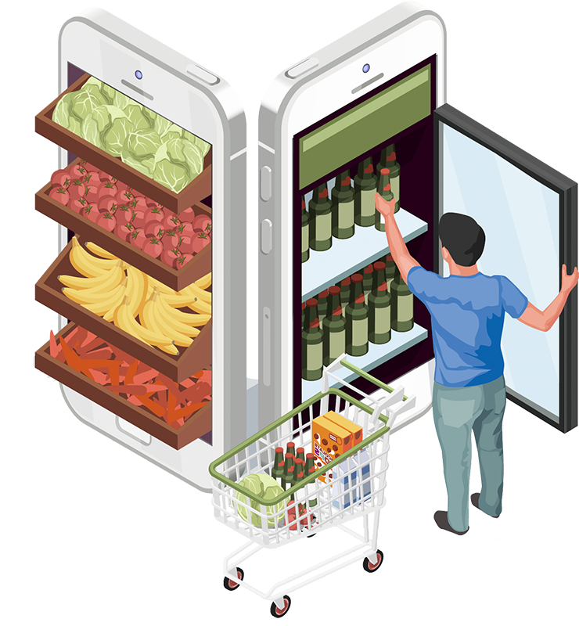
Get to know us
02

Slide 7
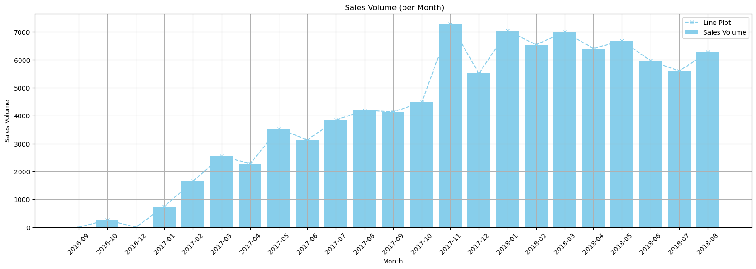
An e-commerce company based in Belgium
During the two-year period we are focusing on there is a significant statistical increase in sales.

Slide 8

Key elements
03

Slide 9
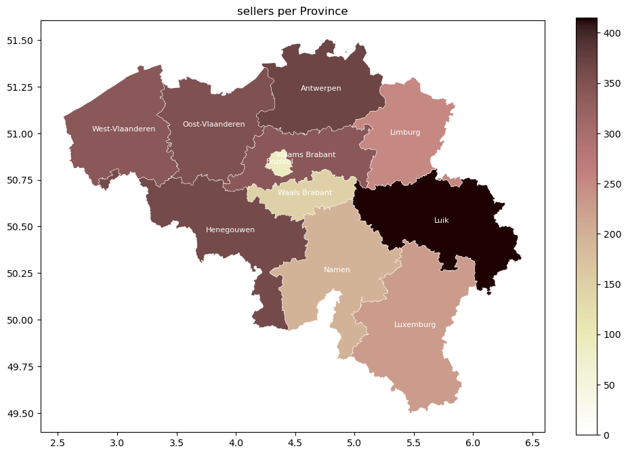
Sellers
We have 3095 unique sellers.
Province | Number of sellers
Luik | 415
Antwerpen | 369
Henegouwen | 363
Oost-Vlaanderen | 351
Vlaams Brabant | 340
West-Vlaanderen | 339
Limburg | 252
Luxemburg | 228
Namen | 197
Waals Brabant | 149
Brussel | 92

Slide 10
Sellers
Top seller has €225032,83 worth of sales.
The average sales amount for sellers is €4409,09.
Seller | Sales percentage
Rank 1 | 1.72
Rank 2 | 1.67
Rank 3 | 1.50
Rank 4 | 1.46
Rank 5 | 1.43

Slide 11
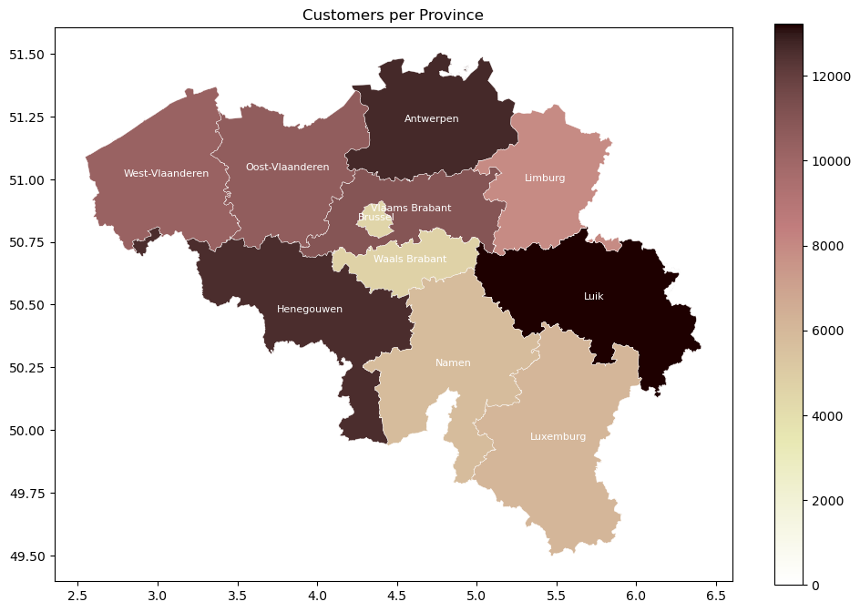
Customers
Total number of customers is 99441 that 61150 of them have purchased at least once.
Province | Number of customers
Luik | 13227
Antwerpen | 12669
Henegouwen | 12596
Vlaams Brabant | 10998
Oost-Vlaanderen | 10578
West-Vlaanderen | 10272
Limburg | 7953
Luxemburg | 6122
Namen | 5825
Waals Brabant | 4687
Brussel | 4514

Slide 12
Customers
Top customer has purchased €13477,90 worth of products.
The average of purchase amount for customers is €213,35.
Customer | Purchase percentage
Rank 1 | 0.103
Rank 2 | 0.055
Rank 3 | 0.053
Rank 4 | 0.051
Rank 5 | 0.050

Slide 13
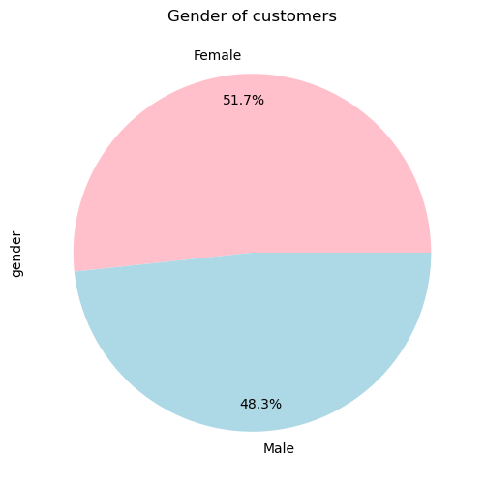
Customers

Slide 14
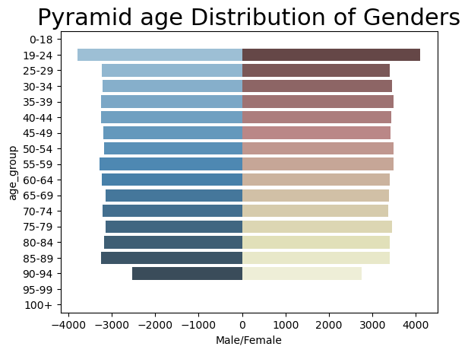
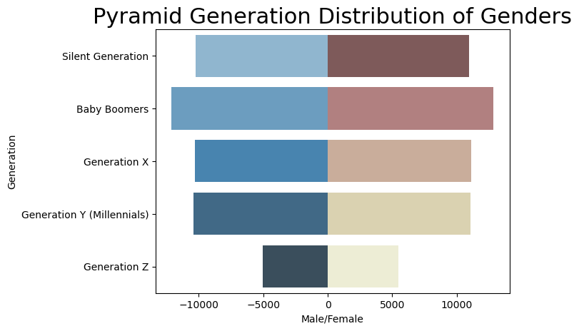
Customers

Slide 15
Products
There is 32951 unique products in the database, so far 31886 of them have been purchased at least once.
Product | Sales percentage
Rank 1 | 0.48
Rank 2 | 0.40
Rank 3 | 0.35
Rank 4 | 0.34
Rank 5 | 0.32
Product | Sales percentage
Rank 1 | 0.47
Rank 2 | 0.44
Rank 3 | 0.43
Rank 4 | 0.35
Rank 5 | 0.35
Ranking by total sales price
Ranking by total sales count

Slide 16

Customer
feedback
04

Slide 17
Proportion of Reviews with Comments
57 % NAN
43% COMMENTS
Submitting scores for orders is a requirement
The comments are in various languages

Slide 18




Language of Comments
nl
45%
45%
10%
de,en
fr

Slide 19
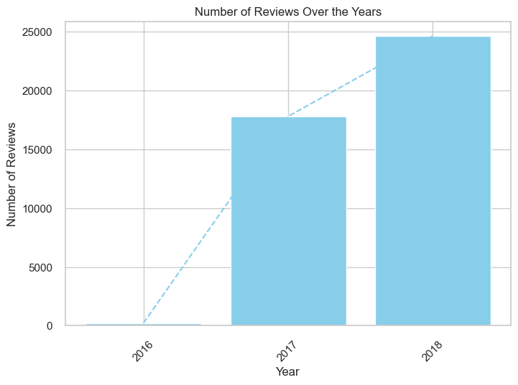
Customer Interaction Trend

Slide 20
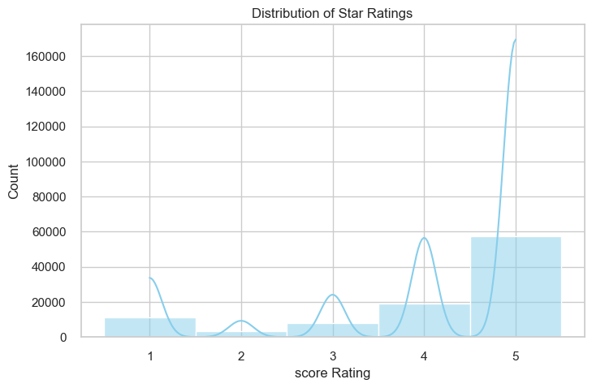
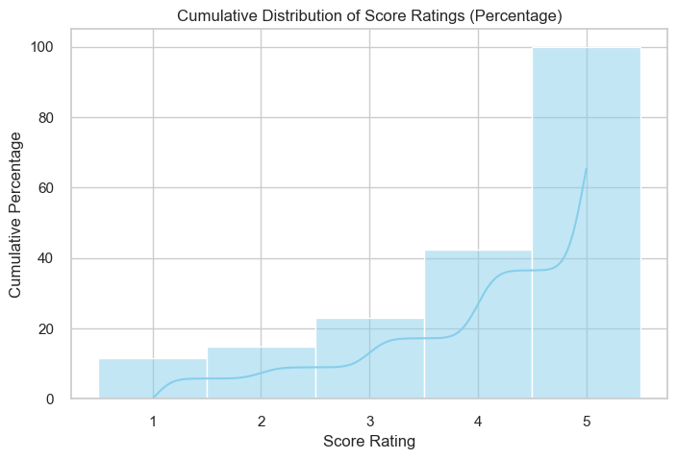
Exploring the Distribution of Score

Slide 21
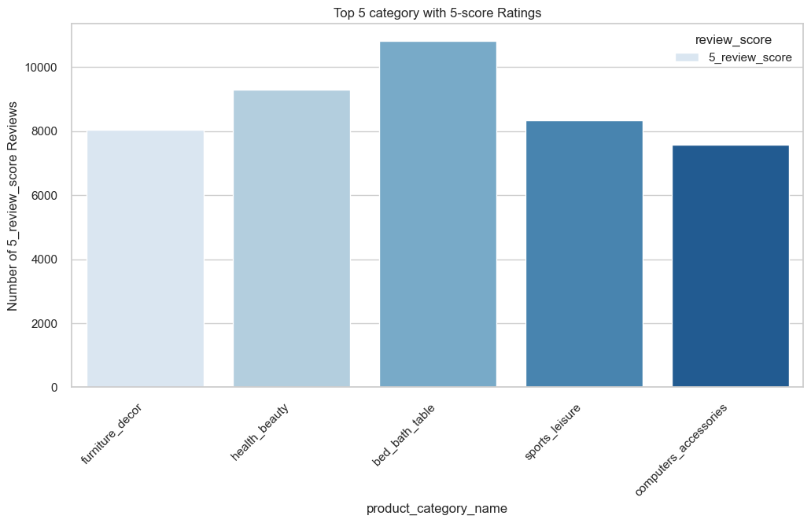
Highest Rated Categories

Slide 22
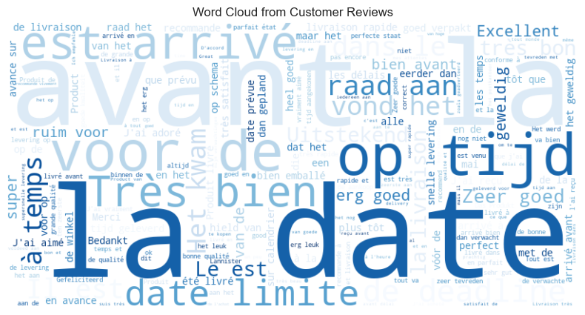
Word Cloud

Slide 23
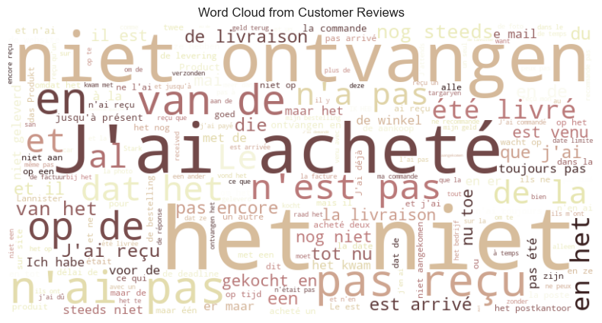
Word Cloud

Slide 24

Delivery
05

Slide 25
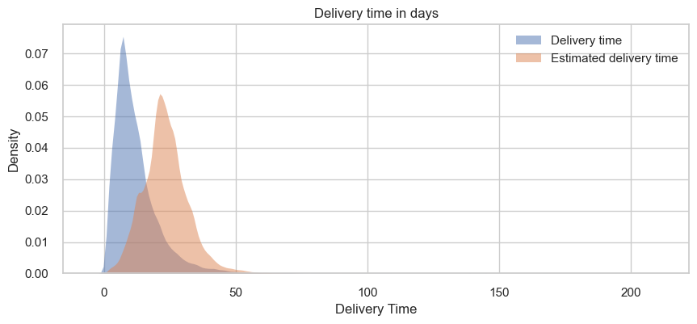
Delivery time and estimated delivery time

Slide 26
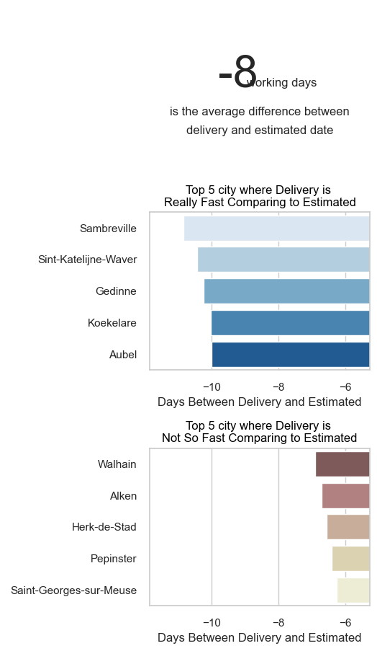
Delivery time and estimated delivery time

Slide 27
limit date for handling the order over to the logistic partner
90%
Meeting Deadlines

Slide 28
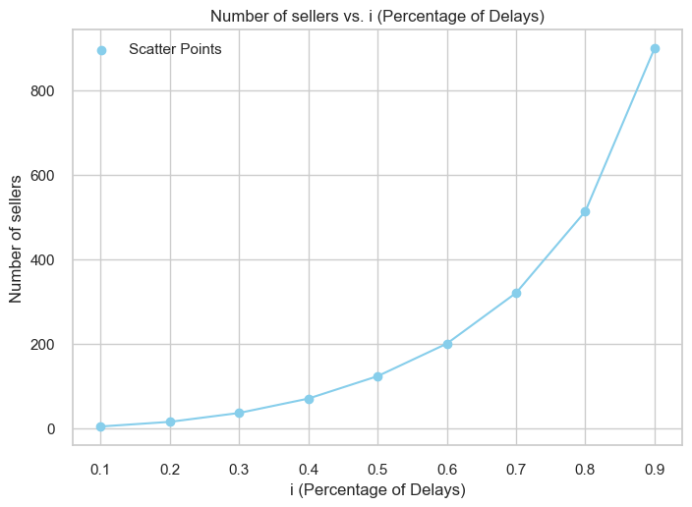
limit date for handling the order over to the logistic partner
Less than 200
Cause 50%

Slide 29
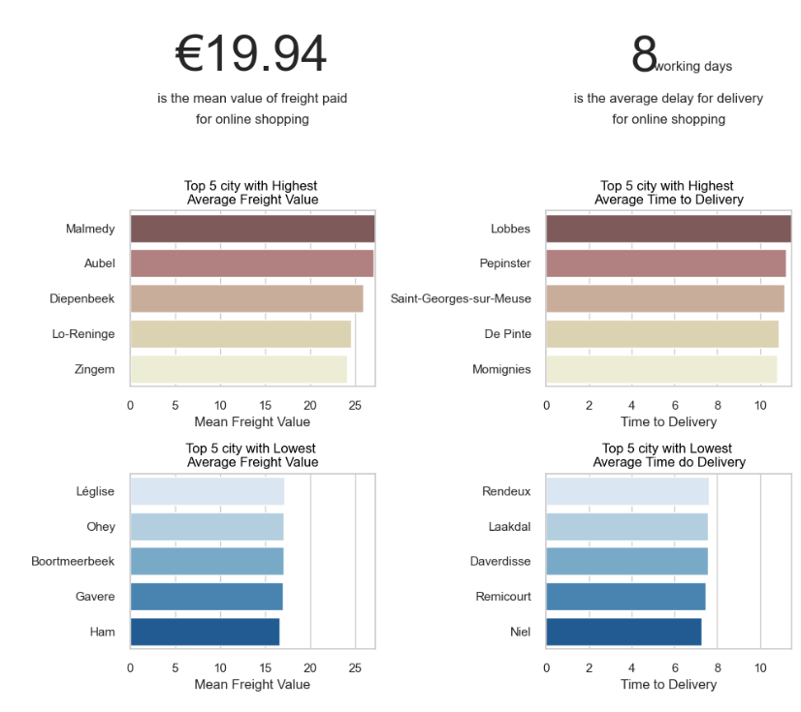
Freight and delivery time

Slide 30
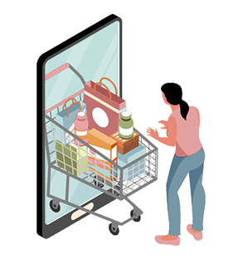
06
Customer
Behavior

Slide 31
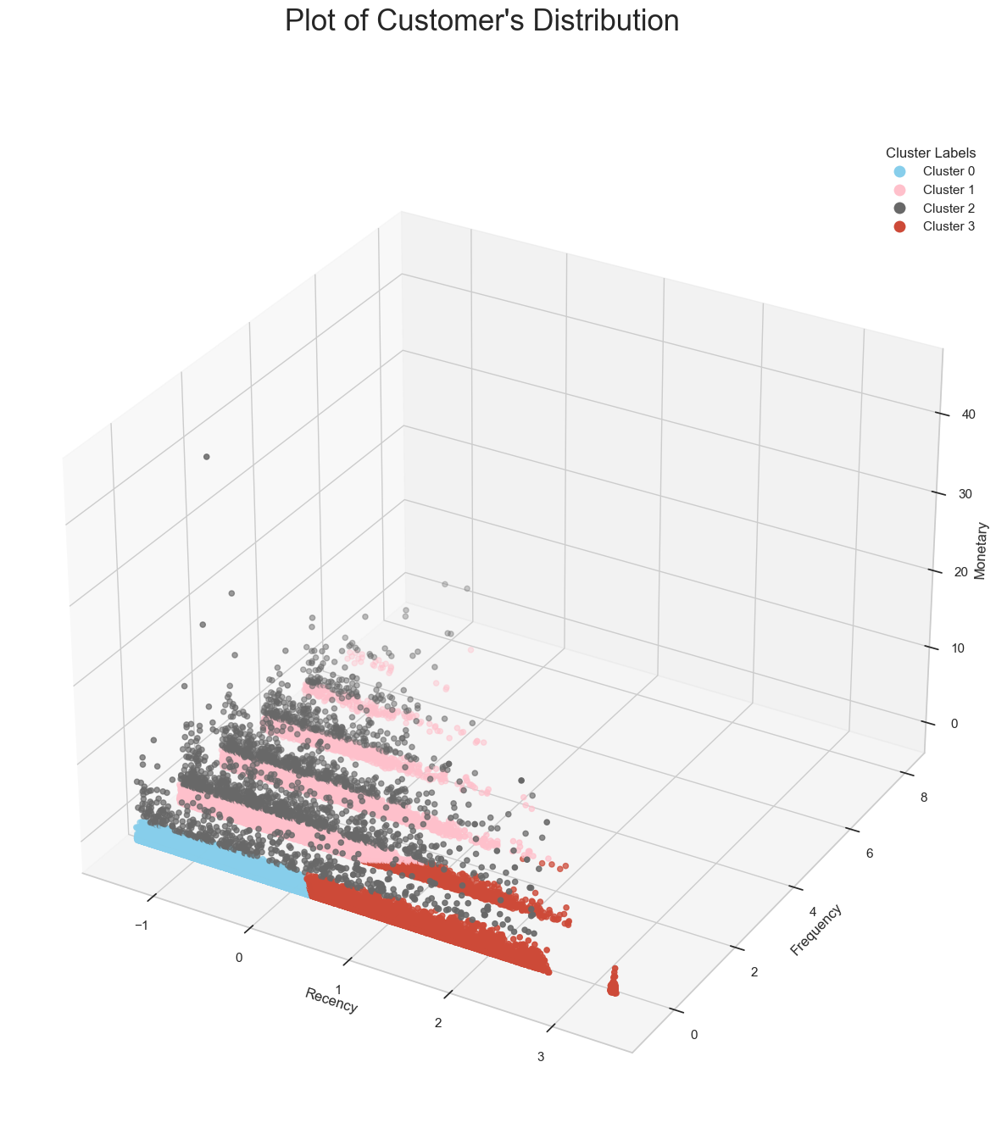
HOW

Slide 32
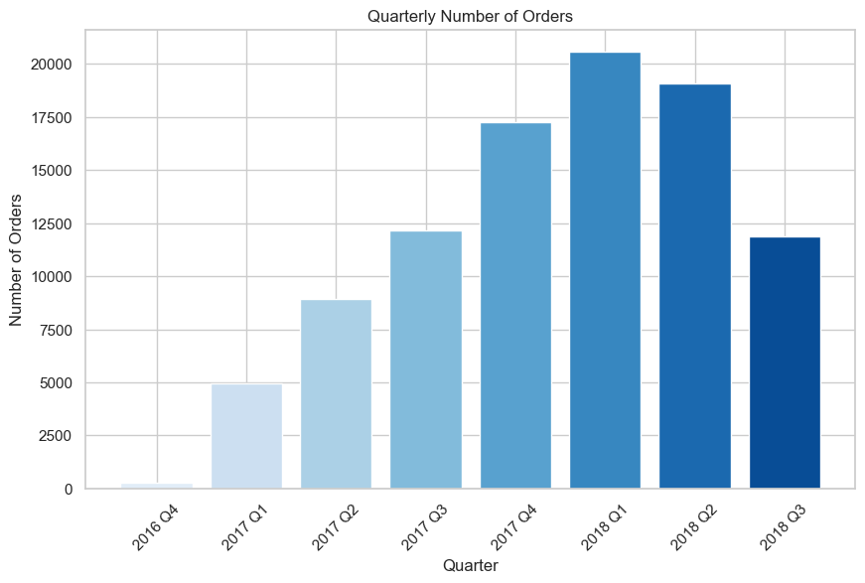
WHEN
First Outlook:
There is a certain upwards trend
Seasonality is not immediately recognizable from the graph

Slide 33
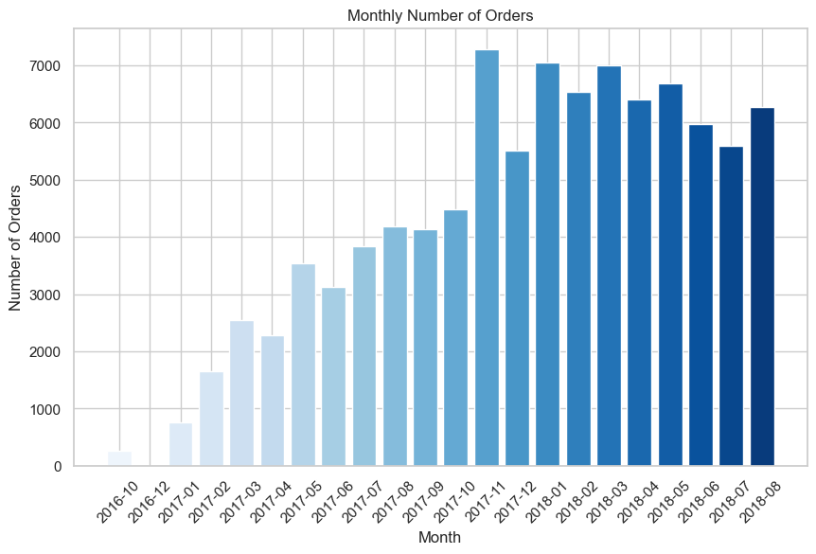
WHEN
The KPSS (Kwiatkowski-Phillips-Schmidt-Shin) test
Null Hypothesis: Data is stationary
Test statistic for monthly orders: 0.13
P value > 0.05
We fail to reject the null hypothesis there is no strong seasonality

Slide 34
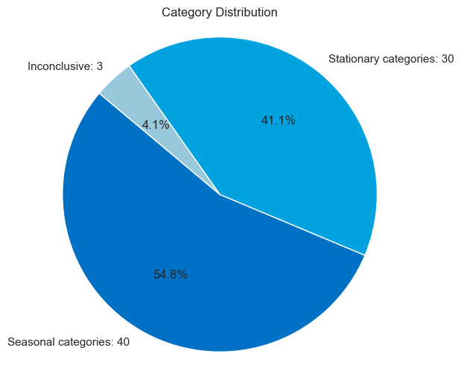
WHEN
Top 10 most seasonal categories:
Food
Furniture Decor
Signaling and Security
Health Beauty
Auto
Books General Interest
Pet Shop
Costruction Tools Garden
Baby
Housewares

Slide 35
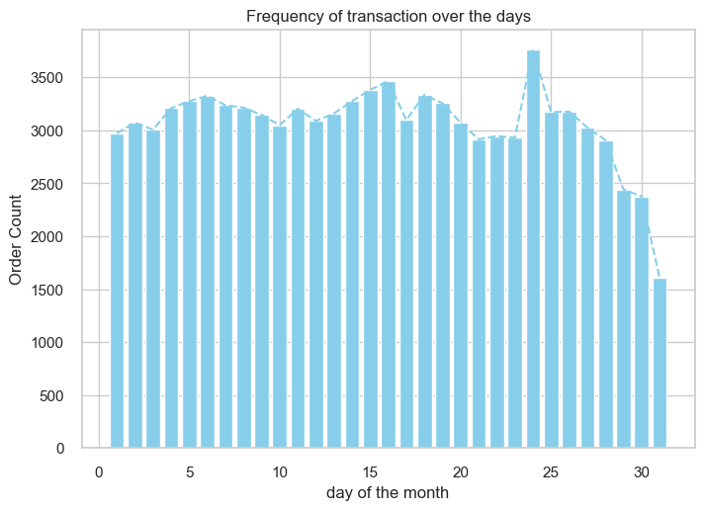
WHEN

Slide 36
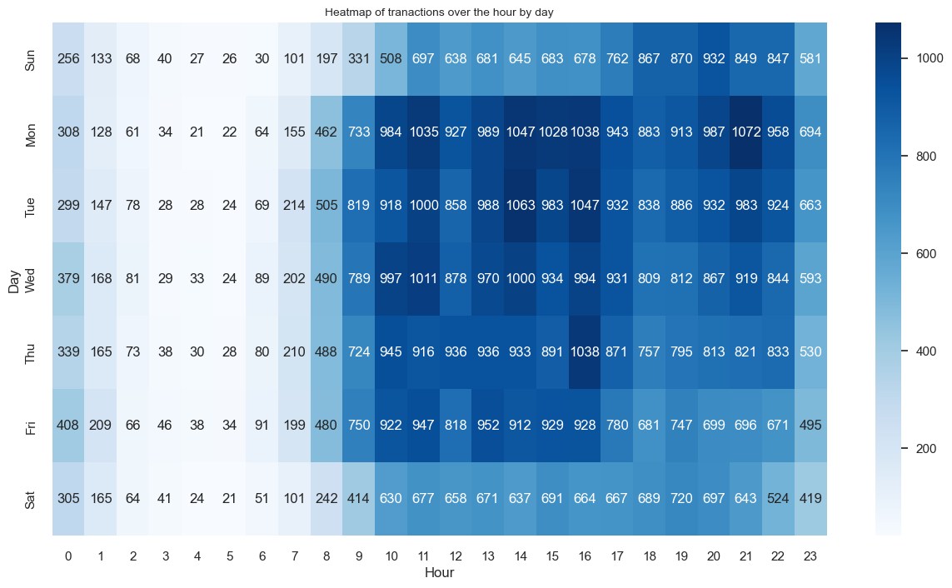
WHEN

Slide 37
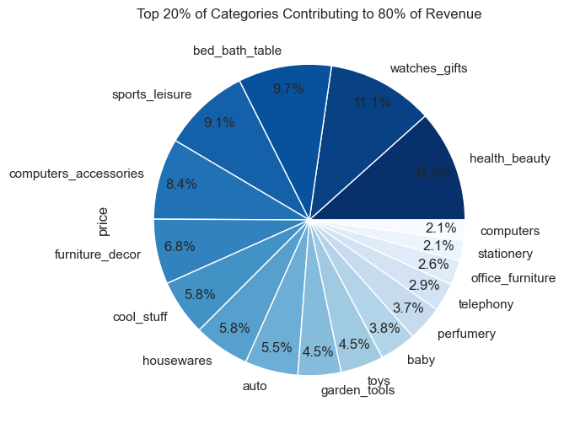
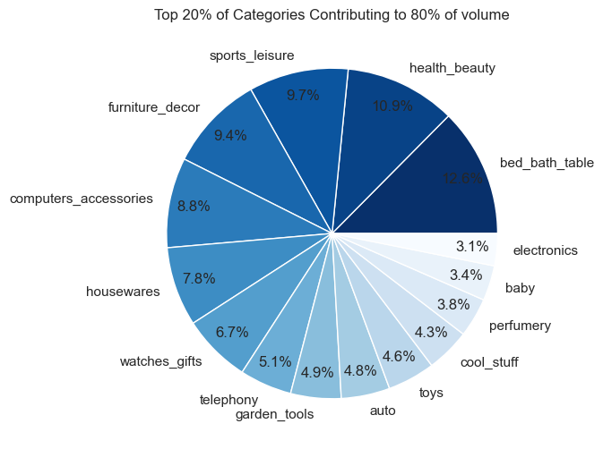
WHAT

Slide 38
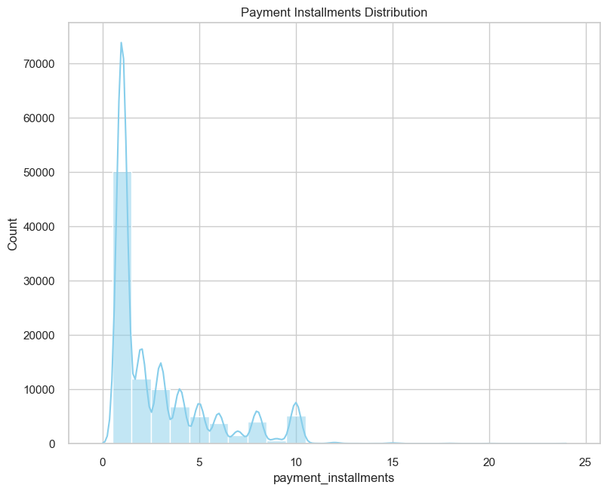
HOW

Slide 39
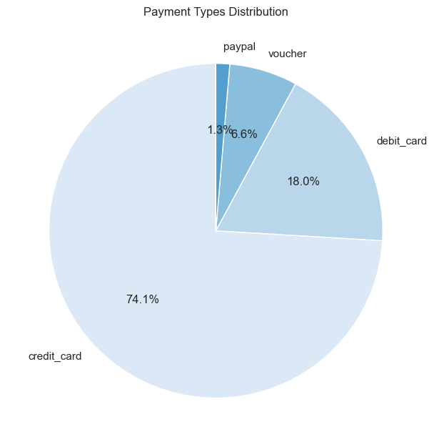
HOW

Slide 40
Recommendations
Creating welcome promotions to better convert signups to purchasers
Rolling out loyalty programs to increase customer retention
Reviziting delivery time estimation method
Optimizing notification and discount timing
Penalizing sellers with delivery issues
Utilizing seasonal campaigns on a product category level
Focusing on high volume and high revenue product categories

